Slide 1














THREE STEP GUIDE TO BECOMING A BILLIONAIRE
Srinidhi Venkatesh & Isabella Szalay

Slide 2

ABOUT:
Dataset: Kaggle - 'Forbes Billionaires and Companies 2022'
Our 2 datasets include data from Forbes surrounding the world's top billionaires and companies (profits, assets, sales revenues and market values).
The 3 main factors we'll be looking at are: Category, Age, & Country
https://www.kaggle.com/datasets/shrikrishnaparab/forbes-billionaires-and-companies-2022

Slide 3
TABLE OF CONTENTS
01
02
TIDYING
GRAPHS
Separation of columns, cleaning data, gsub
Country, Category, Age
03
04
APP
VISUAL
Shinyapp, NPM
Final Outcome

Slide 4
TIDYING
01

Slide 5
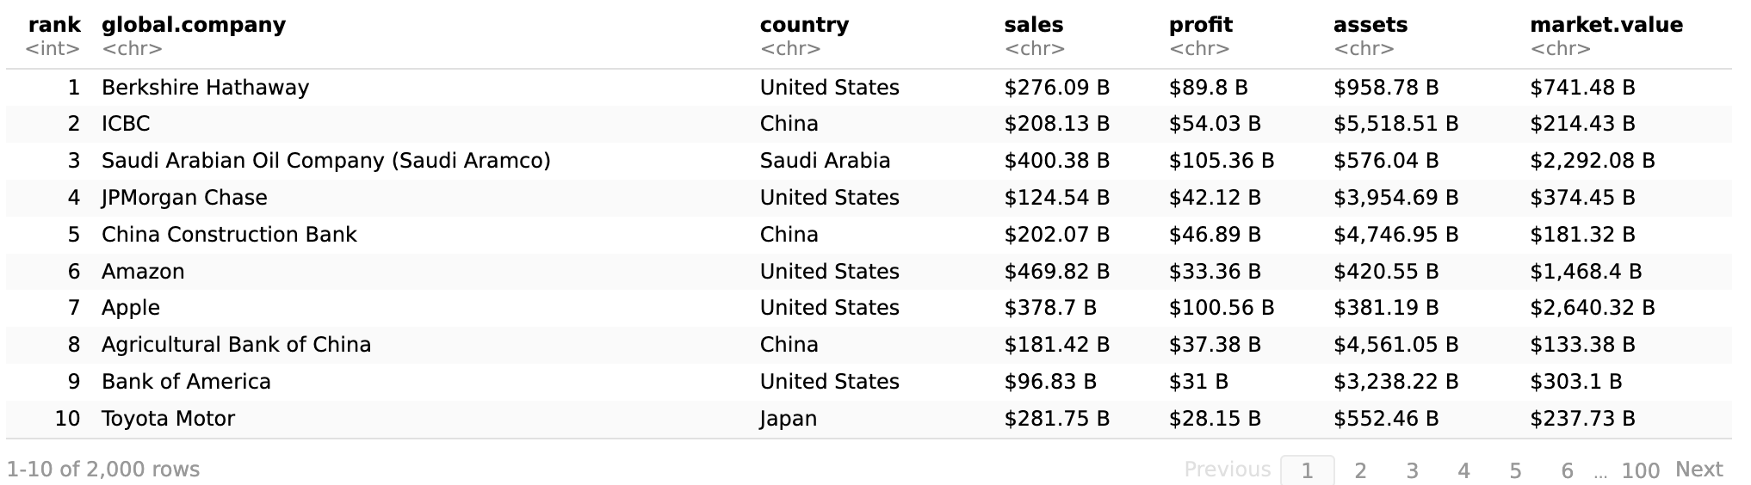

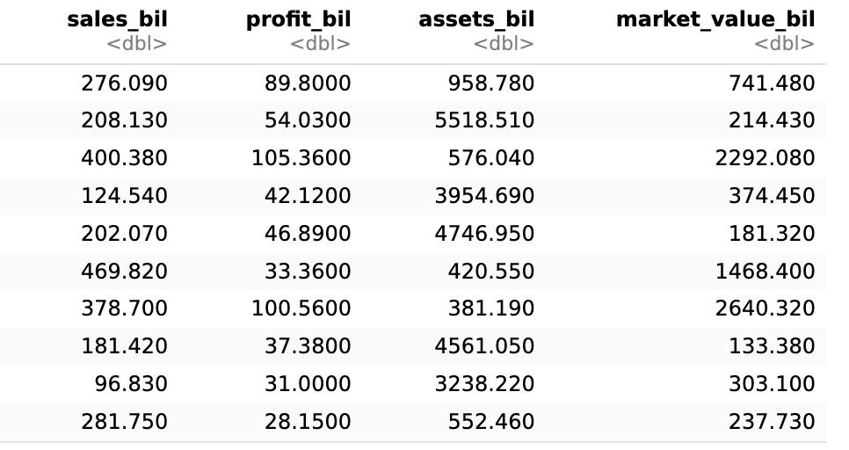
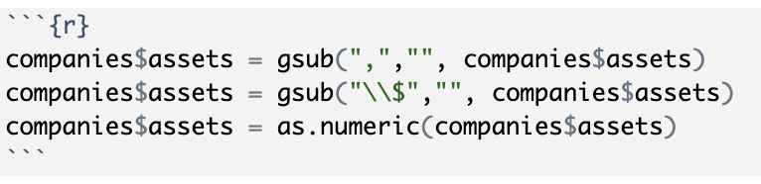

TIDYING
Original format: '$100B'
Tidying: Separating B/M, getting rid of $ (gsub), turning values from character to numeric, Millions to Billions
Final Format

Slide 6
GRAPHICAL ANALYSIS
02

Slide 7
Category (Field)
Age
Country

Slide 8
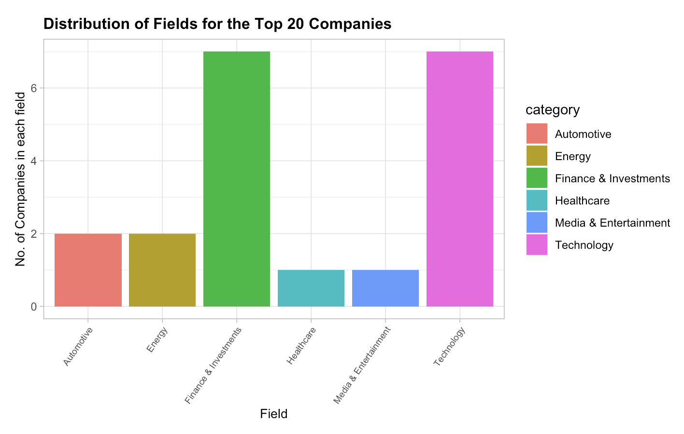
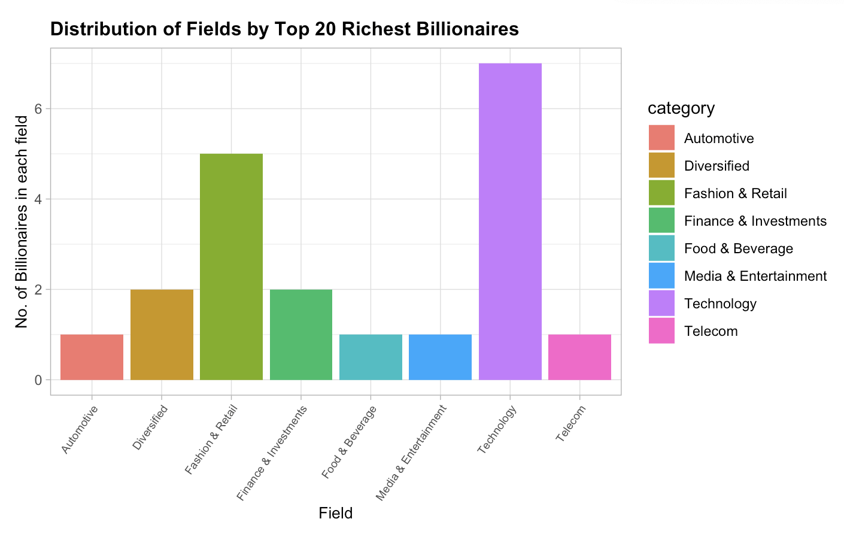
What Field Should You Be In?
Looking at the 20 most profitable companies, the fields of Technology and Finance & Investments were the most abundant.
For the 20 wealthiest billionaires (final worth), the top fields to be are Technology and Fashion & Retail
Conclusion: Work in Technology or Finance & Investments to be on the path to becoming a Billionaire.

Slide 9
Category (Field)
Age
Country

Slide 10
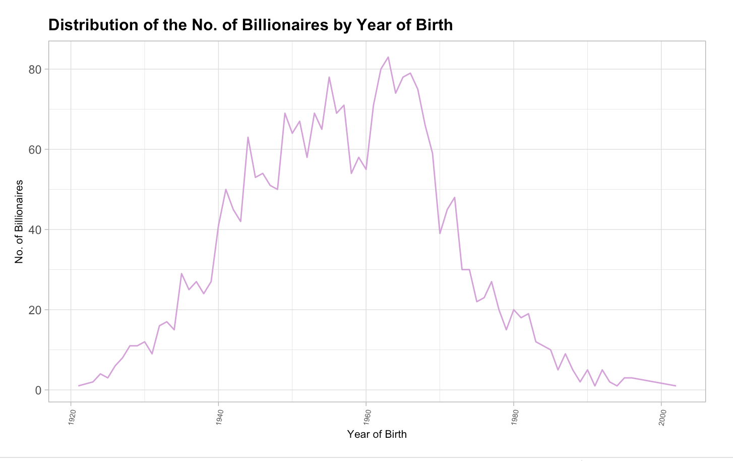
When To Expect Your Billions
At what age will you be most profitable and maximize your wealth?
The year 1963 sees the most Billionaires, which means that at around 60 (2023-1963) you have the greatest chances of being a Billionaire.

Slide 11
Category (Field)
Age
Country

Slide 12
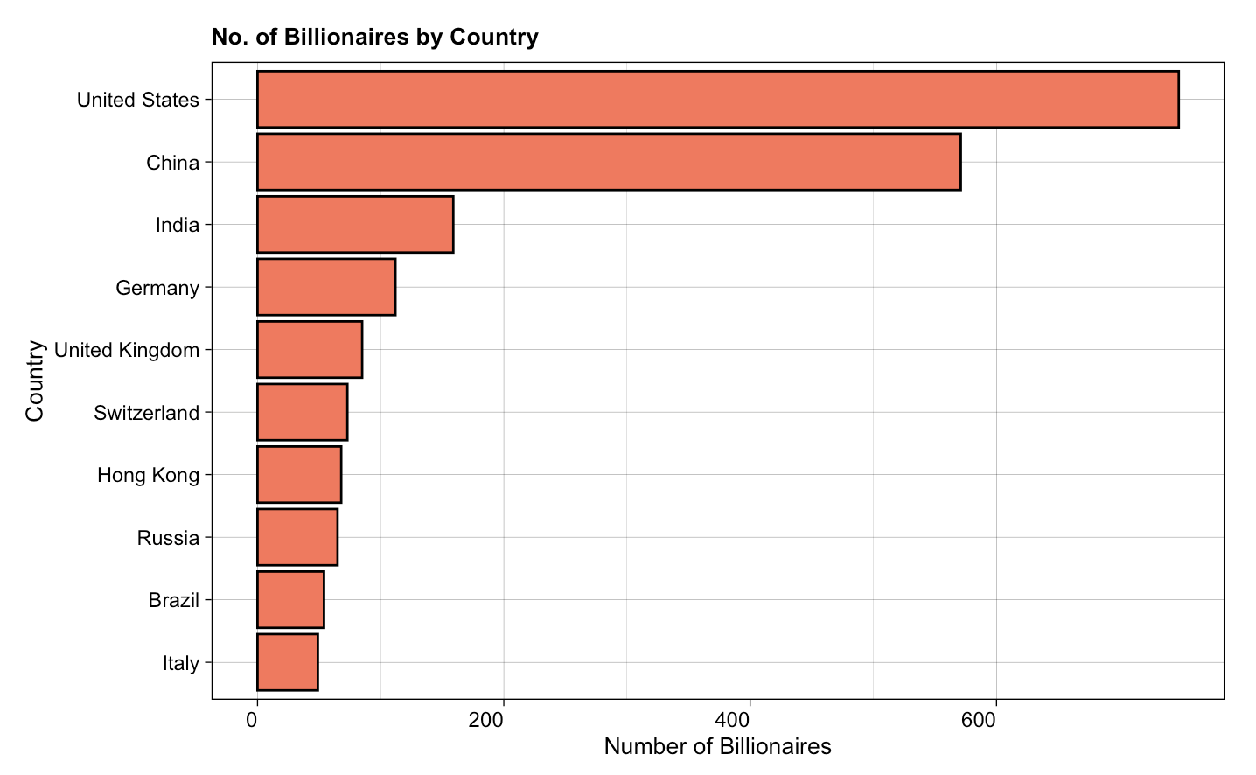
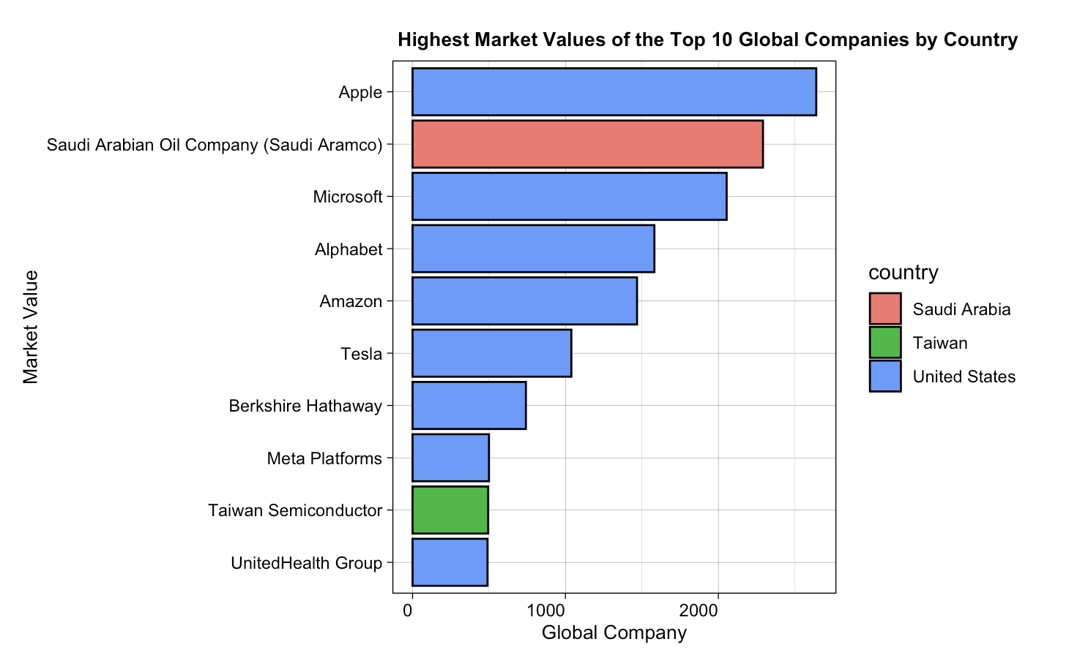
Which Country Produces The Most Profitable Billionaires and Companies?
What country has the highest proportion of Billionaires?
Which companies have the highest market values by country?
As seen, the United States appears to be the best place for the wealthiest companies and people. But which states in the US are best to be wealthy?

Slide 13

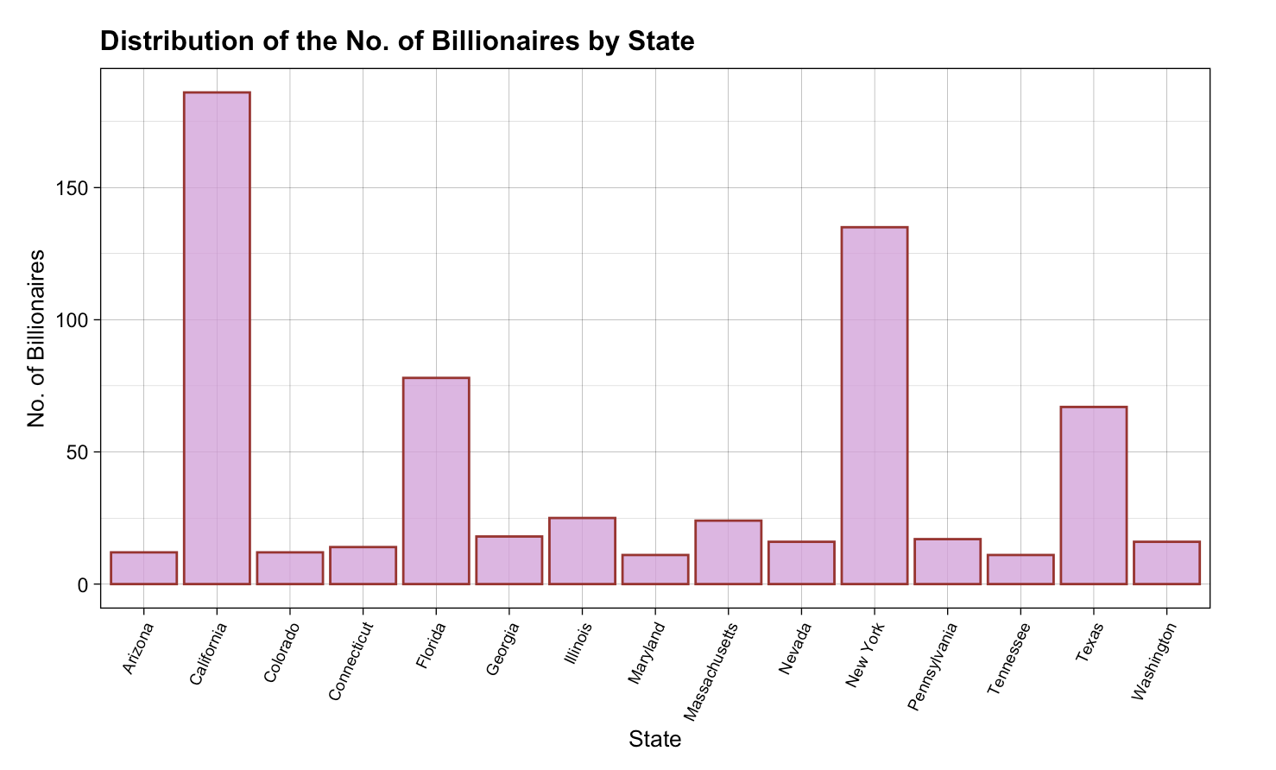

States With the Most Billionaires
Top 3 states: California, New York, Florida

Slide 14
SHINY APP
03

Slide 15
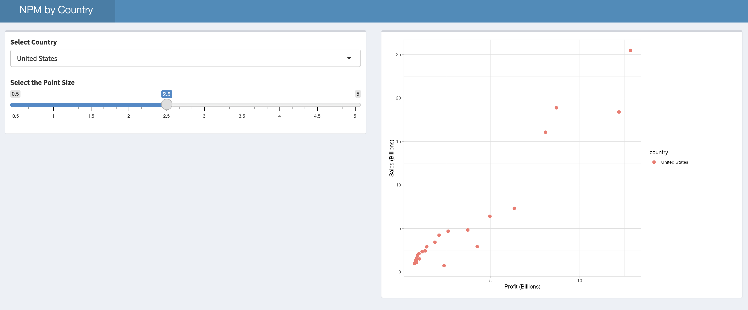
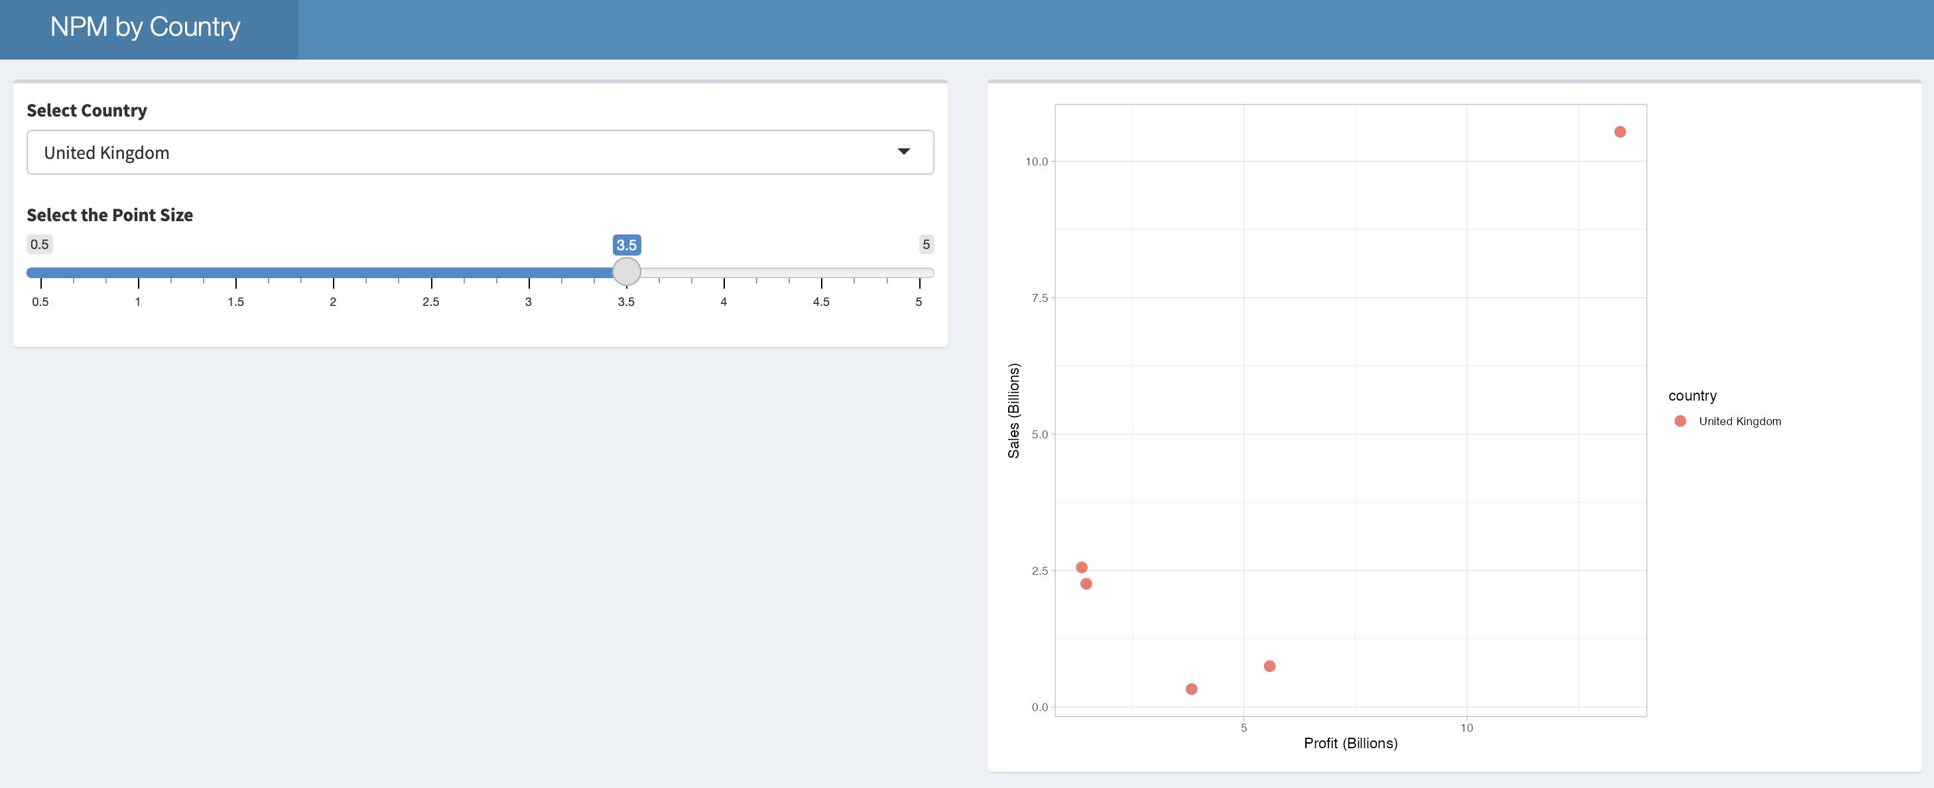
SHINY APP
The Net Profit Margin (=Profit/Sales) was arranged by country, shows the best profit margins for each country – the United States had the most companies with the highest NPM

Slide 16
VISUAL
04

Slide 17
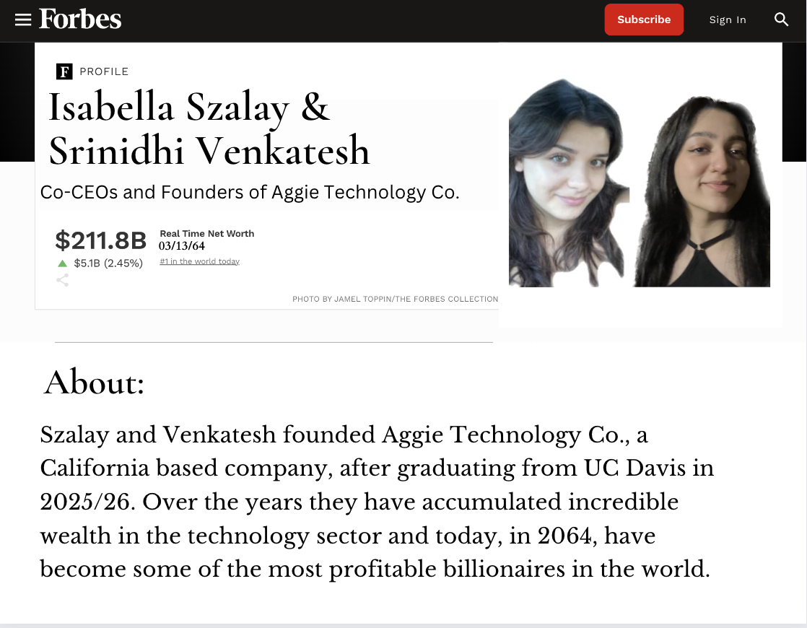

Slide 18
THANK YOU
**!!disclaimer- we hold no liability if you aren't a billionaire after following these steps!!**

